Slide 1
Optimizing Portfolio Allocation: A Comprehensive Analysis
ADMN5006: Financial Analytics
Presented by Pimlapas Narongrit | Jettawat Vuttipakdee | Devesh Srewal Deepak | Qi Guo | Sai Priya Kaipu
2024 – 04 – 14
Notes:
Today we are here to present you our portfolio and investment suggestions with you. Our focus is on our careful study of market trends and individual stock performance.

Slide 2
Agenda
1
2
3
4
Introduction
Fundamental & Quantitative Analysis
Recommendation Package
Q&A Session

Slide 3
1
Introduction

Slide 4
Introduction
Providing investment recommendations for client's $100,000 portfolio.
Purpose
Conducted thorough fundamental and quantitative analyses.
Approach
Convince client through insightful findings and clear recommendations.
Goal

Slide 5
Portfolio Composition
Industry | Company | Stock
Technology/Software | Microsoft | MSFT
Financial Services/Banking | JP Morgan | JPM
Consumer Goods/Beverages | Coca Cola | KO
Energy/Oil & Gas | Exxon Mobil | XOM

Slide 6
2
Fundamental & Quantitative Analysis
Notes:
We are conducting both fundamental and quantitative analysis to ensure a Comprehensive understanding of potential investment opportunities

Slide 7

Technology/Software Industry

Slide 8
Technology/Software Industry Environmental Analysis
Strengths
Highly innovative with the ability to scale solutions globally, driving high profit margins through diverse applications across sectors.
Weaknesses
Struggles with quickly becoming outdated and high research costs, while constantly dealing with threats to online security.
Opportunities
Expanding markets in cloud computing, AI, and IoT present significant growth prospects
Threats
Regulatory changes, especially in data privacy, and the risk of technological disruption by newer technologies or startups

Slide 9
Microsoft Financial Analysis
Industry Comparison: MSFT’s YOY growth has consistently outperformed the industry average of 2.8%.
Notes:
The graph depicts Microsoft's Year-Over-Year (YOY) revenue growth from 2019 to 2023
·MSFT's Growth: Microsoft has shown a fluctuating but overall strong revenue growth, peaking in 2021 and 2022 before declining in 2023 but still above industry average.
·Industry Comparison: MSFT’s Year-Over-Year growth has consistently outperformed the industry average of 2.8%
·Outlook: Considering the past performance, The decline in 2023 might represent a normalization after exceptional growth years.

Slide 10
Microsoft Financial Analysis
Industry Comparison: MSFT's P/E ratio is close to the industry average of 33.36, indicating that its valuation is in line with market expectations for its sector.
Notes:
●The P/E ratio, or Price-to-Earnings ratio, is a financial metric used to evaluate the valuation of a company's stock. It is calculated by dividing the current market price per share of the company's stock by its earnings per share (EPS).
●A higher P/E ratio generally indicates that investors are willing to pay more for each unit of earnings, suggesting that the stock may be overvalued. Conversely, a lower P/E ratio suggests that the stock may be undervalued relative to its earnings potential.
●MSFT's P/E Trend: Microsoft’s P/E ratio shows a downward trend from 2020 to 2022, with a recovery in 2023. It’s now just above the industry average.
●Industry Comparison: MSFT's P/E ratio is close to the industry average of 33.36, indicating that its valuation is in line with market expectations for its sector.
●Outlook: A P/E ratio close to the industry average suggests that MSFT is fairly valued. However, given the company's strong revenue growth, there could be potential for future appreciation if growth continues.

Slide 11
Microsoft Financial Analysis
Industry Comparison: With the industry average at 0.35, MSFT’s ratio is lower, indicating less reliance on debt financing.
Notes:
●The Debt-to-Equity (D/E) ratio is a financial metric used to evaluate a company's financial leverage by comparing its total debt to its total equity. It's calculated by dividing the company's total liabilities (debt) by its total shareholders' equity.
MSFT's Leverage: Microsoft’s debt to equity ratio has been decreasing, which is a positive indicator of financial health.
Industry Comparison: With the industry average at 0.35, MSFT’s ratio is lower, indicating less reliance on debt financing.
Outlook: A low and decreasing debt to equity ratio suggests financial stability and a solid balance sheet, which is attractive to investors.
Overall Microsoft MSFT shows strong growth with a fair valuation and a healthy balance sheet. The decrease in the debt to equity ratio is particularly positive, reflecting a conservative financial strategy.
Microsoft appears to be well-positioned for future growth, with solid financials and a strategy aligned with industry trends. The company’s growth and valuation are in sync with the industry, making it a potentially strong contender in its sector.

Slide 12



Microsoft Company Analysis
Dominates the technology and software industry with a diverse portfolio of products and services.
Focus on cloud computing, artificial intelligence, and productivity tools.
Strategic acquisitions like GitHub and LinkedIn enhance market position.
Facing scrutiny regarding data privacy and antitrust concerns.
Notes:
Microsoft continues to dominate the technology and software industry with its diverse portfolio of products and services.
Its focus on cloud computing, artificial intelligence, and productivity tools has enabled it to maintain a strong competitive edge.
Recent strategic acquisitions like GitHub and LinkedIn have further solidified its position in the market.
However, increasing scrutiny regarding data privacy and antitrust concerns may pose challenges in the regulatory landscape.

Slide 13
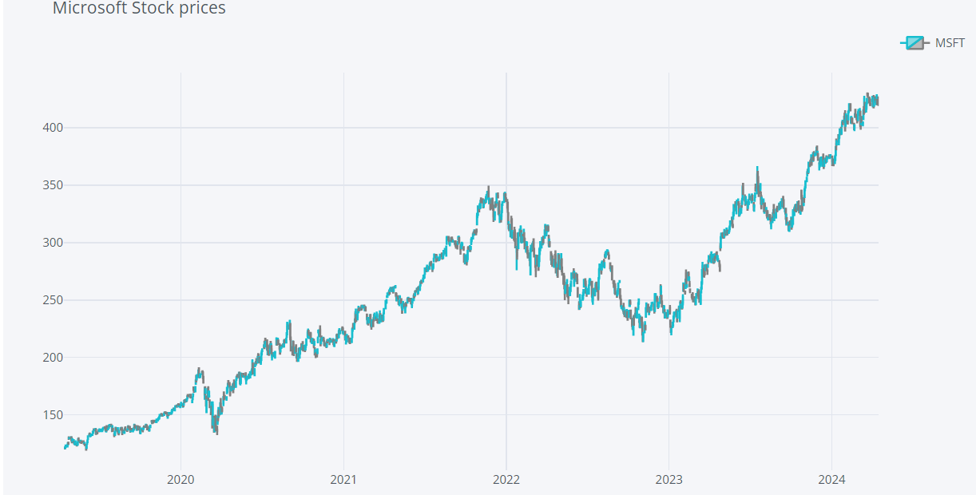
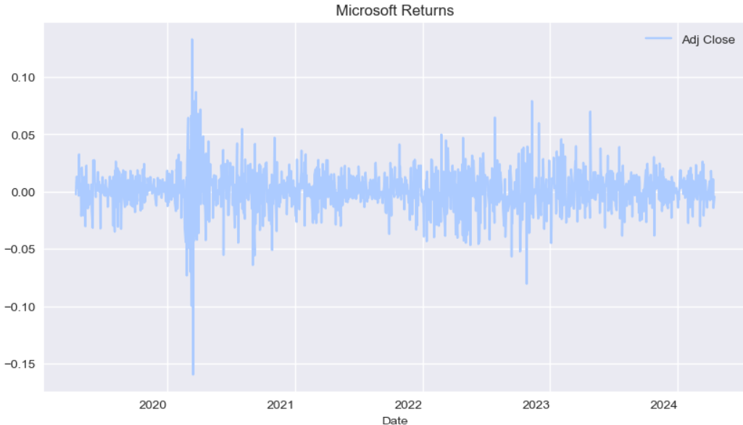
Microsoft’s Past Performance
Microsoft demonstrated significant growth over the past 5 years with a fluctuation between 2022 to 2023. In terms of its returns, there was a consistent return within this timeframe however there were some differences between 2020 to 2021 and the expected return is 26% within one year.
Stock Price
Returns
Notes:
Microsoft demonstrated significant growth over the past 5 years with a fluctuation between 2022 to 2023.
The "Stock Price" graph is a line chart that shows the price of Microsoft's stock from 2020 to early 2024. It indicates a general upward trend in stock price, suggesting that the company has been performing well financially.
In terms of its returns, there was a consistent return within this timeframe however there were some differences between 2020 to 2021 and overall there has been positive return, particularly an expectation of 26% in one year.

Slide 14
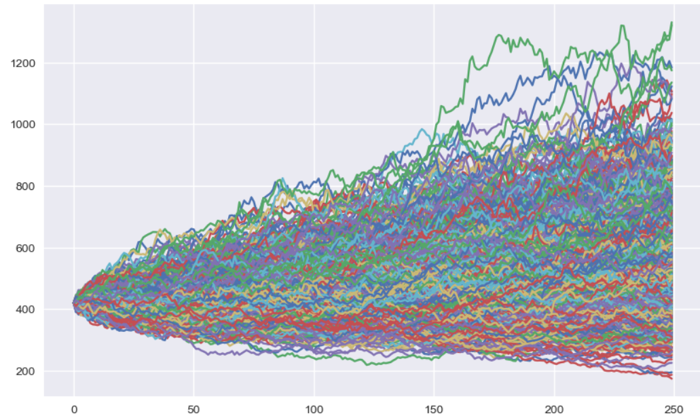
Microsoft Monte Carlo Simulation
The simulated prices for Microsoft show that prices are set between $1330.27 and $174.31 with an average of $486.14 and a standard deviation of $116.58 within a one-year timeframe. This demonstrates that Microsoft is highly varied However, by seeing the average simulated price, we can expect that the price of Microsoft will rise in the future.
Notes:
To perform Monte Carlo Simulation we used 1000 iterations for the simulation of one year price
The simulated prices for Microsoft show that prices are set between $1330.27 and $174.31 with an average of $486.14 and a standard deviation of $116.58 within a one-year timeframe.
This demonstrates that Microsoft is highly varied However, by seeing the average simulated price, we can expect that the price of Microsoft will rise in the future.

Slide 15

Financial Services/Banking Industry

Slide 16
Financial Services/Banking Industry Environmental Analysis
Strengths
Established trust and brand value, with multiple revenue streams from interest, fees, and financial services.
Weaknesses
Vulnerable to financial crises and cyber-attacks, with heavy reliance on regulatory compliance.
Opportunities
Digital banking and fintech innovations offer paths for expansion and efficiency improvements.
Threats
Economic downturns and increasing competition from fintech companies pose significant risks.
Notes:
Financial Services/Banking Industry:
Strengths:
Established reputation and brand recognition.
Diversified revenue streams including lending, investment banking, and wealth management.
Access to vast amounts of customer data for personalized financial services.
Weaknesses:
Exposure to economic cycles and interest rate fluctuations.
Regulatory compliance requirements increasing operational costs.
Vulnerability to financial fraud and cyberattacks.
Opportunities:
Expansion into emerging markets with growing middle-class populations.
Adoption of financial technology (fintech) to improve efficiency and customer experience.
Innovation in digital banking, mobile payments, and blockchain technology.
Threats:
Competition from fintech startups and non-traditional financial institutions.
Regulatory changes impacting lending practices and capital requirements.
Economic instability and geopolitical uncertainties affecting market volatility.

Slide 17
JP Morgan Financial Analysis
Industry Comparison: JPM’s YOY growth has been somewhat inconsistent but has a dramatic increase in 2023 that surpasses the industry average of 6.2%.

Slide 18
JP Morgan Financial Analysis
Industry Comparison: JPM’s P/E ratio is higher than the industry average of 9.63, indicating that the market may expect higher earnings growth from JPM.

Slide 19
JP Morgan Financial Analysis
Industry Comparison: JPM’s debt-to-equity ratio has consistently been far above the industry average of 0.28. This is indicative of higher leverage and a more aggressive capital structure.

Slide 20




JP Morgan Company Analysis
The powerhouse in financial services, including investment banking and asset management.
Strong risk management practices and technological innovations.
Global presence and solid financial performance.
Regulatory pressures and legal challenges are occasional hurdles.
Notes:
JP Morgan (Financial Services/Banking): JP Morgan remains a powerhouse in the financial services sector, boasting a strong presence in investment banking, asset management, and retail banking. Its robust risk management practices and technological innovations have allowed it to navigate volatile market conditions effectively. Despite regulatory pressures and occasional legal challenges, JP Morgan's solid financial performance and global reach position it as a leader in the banking industry.

Slide 21
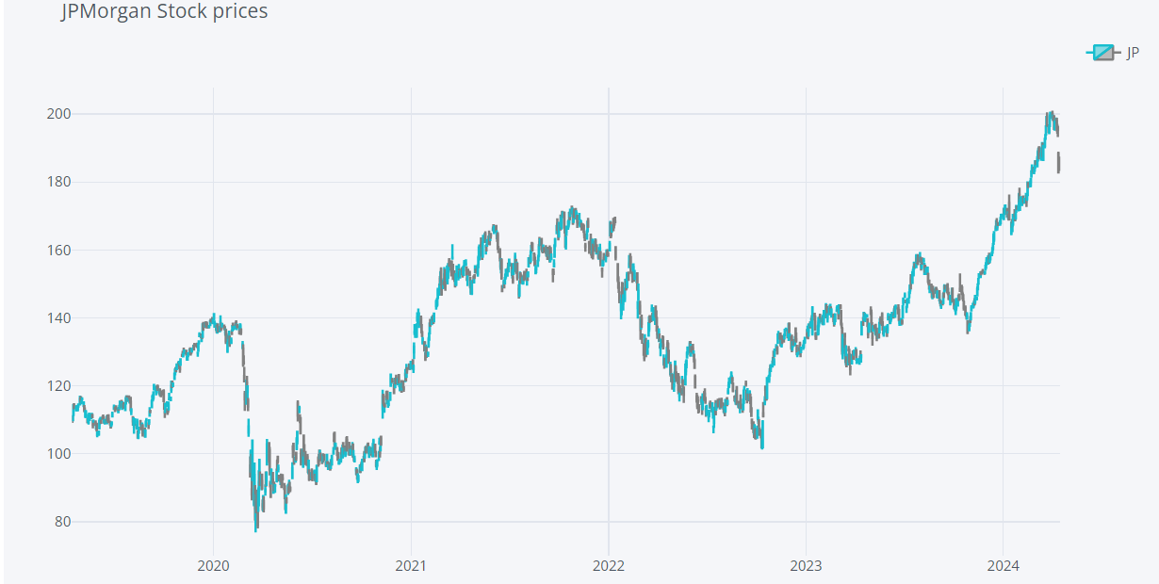
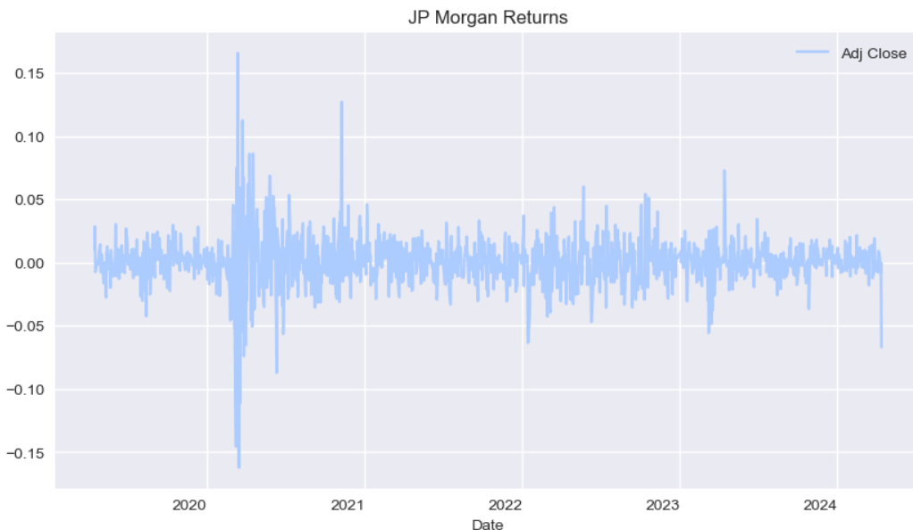
JP Morgan’s Past Performance
JP Morgan showed a variation in terms of its price with a significant fluctuation between 2020 to 2021 and 2022 to 2023. However, after this downturn, JP Morgan demonstrated significant growth since 2023. The returns have also consistence over the past 5 years with a high fluctuation between 2020 and 2021 and expected returns of 13% within one year.
Stock Price
Returns

Slide 22
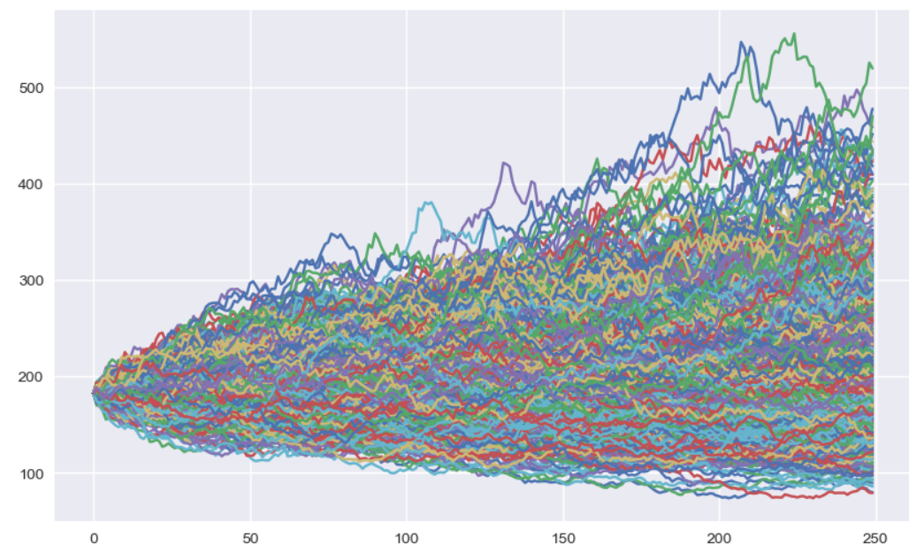
JP Morgan Monte Carlo Simulation
The simulated prices for JP Morgan show that prices are set between $555.69 and $73.65 with an average of $198.18 and a standard deviation of $46.55 within a one-year timeframe. This shows that JP Morgan is consistent in terms of its price.

Slide 23

Consumer Goods/Beverages Industry

Slide 24
Consumer Goods/Beverages Industry Environmental Analysis
Strengths
Strong brand loyalty and extensive distribution networks drive consistent revenue streams.
Weaknesses
High susceptibility to changing consumer preferences and global supply chain disruptions.
Opportunities
Increasing demand for healthy and sustainable products opens new market segments.
Threats
Regulatory pressures on packaging and sustainability, along with intense competition and price wars
Notes:
Consumer Goods/Beverages Industry:
Strengths:
Strong brand recognition and customer loyalty.
Stable demand for essential consumer products.
Extensive distribution networks and global supply chains.
Weaknesses:
Exposure to changing consumer preferences and trends.
Price sensitivity and intense competition in the market.
Vulnerability to supply chain disruptions and commodity price fluctuations.
Opportunities:
Innovation in product development, packaging, and marketing strategies.
Expansion into new markets and product categories.
Health and wellness trends driving demand for healthier beverage options.
Threats:
Regulatory changes impacting advertising, labeling, and ingredients.
Competitive pressures from private label brands and discount retailers.
Environmental concerns and sustainability issues affecting brand reputation.

Slide 25
Coca Cola Financial Analysis
Industry Comparison: Coca Cola's growth outperformed the industry average of 7.4% in 2021 but has since fallen below the average.
Notes:
YOY Revenue Growth:
COKE's Growth: Coca-Cola experienced a significant downturn in 2020, from the COVID-19 pandemic.
However, the company rebounded strongly in 2021 but saw a decrease in the growth rate for the next two years.
Industry Comparison: COKE's growth outperformed the industry average of 7.4% in 2021 but has since fallen below the average.
Outlook: if COKE can stabilize growth rates above the industry average, it could indicate a strong competitive position.

Slide 26
Coca Cola Financial Analysis
Industry Comparison:
The P/E ratio of Coca Cola is currently below the industry average of 24.3.
Notes:
P/E Ratio:
COKE's P/E Trend: The P/E ratio of COKE fluctuated, with an overall decrease over the years, reaching 23.78 in 2023, which could signal an undervaluation if the company's earnings are stable or growing.
Industry Comparison: The P/E ratio of COKE is currently below the industry average of 24.3.
Outlook: A lower P/E ratio compared to the industry might attract investors looking for potentially undervalued stocks.

Slide 27
Coca Cola Financial Analysis
Industry Comparison: Coca Cola's ratio is significantly above the industry average of 0.77, indicating a higher reliance on debt.
Notes:
Debt to Equity Ratio:
COKE's Leverage: Coca-Cola has a relatively high debt to equity ratio, although it has been decreasing steadily from 2019 to 2023.
Industry Comparison: COKE's ratio is significantly above the industry average of 0.77, indicating a higher reliance on debt.
Outlook: Continued reduction in debt, especially when compared to equity, could signal improving financial health and might improve investor confidence.

Slide 28
Coca Cola Company Analysis
Global leader in the beverage industry with an iconic brand portfolio.
Shifting consumer preferences towards healthier alternatives.
Diversification into non-carbonated beverages and sustainability initiatives.
Extensive distribution network and brand recognition.
Notes:
Coca-Cola maintains its status as a global leader in the beverage industry. However, with changing consumer preferences leaning towards healthier alternatives, Coca-Cola has adapted by diversifying its product offerings. This includes expanding into non-carbonated beverages and implementing sustainability initiatives to address environmental concerns.
Despite these shifts, Coca-Cola maintains a competitive edge through its extensive distribution network and strong brand recognition. This allows the company to reach consumers across various markets efficiently while leveraging its brand equity to drive sales and maintain market leadership.

Slide 29
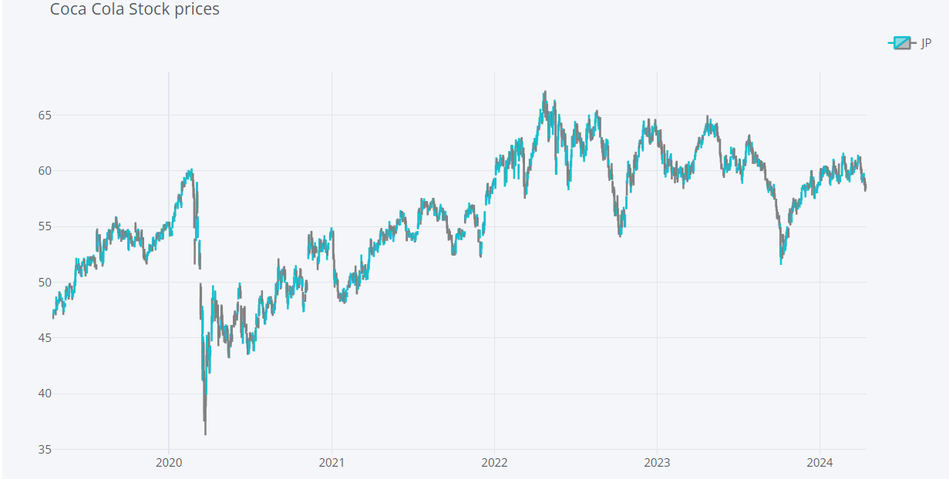
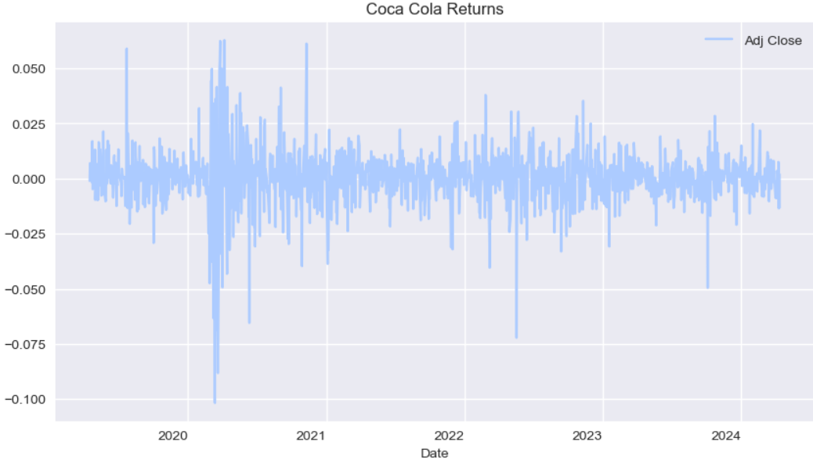
Coca Cola’s Past Performance
Coca-Cola illustrated a moderate variation in terms of its past prices with ups and downs during the past five years. In terms of its return, Coca-Cola also showed variation however, after 2023 the return tends to be consistence and expected return of 7% within one year.
Stock Price
Returns
Notes:
Coca-Cola has exhibited moderate price variation over the past five years, with fluctuations in its stock prices.
Similarly, its returns have shown variability, although after 2023, returns have become more consistent.
We expect a steady return of approximately 7% within the upcoming year based on historical trends.

Slide 30
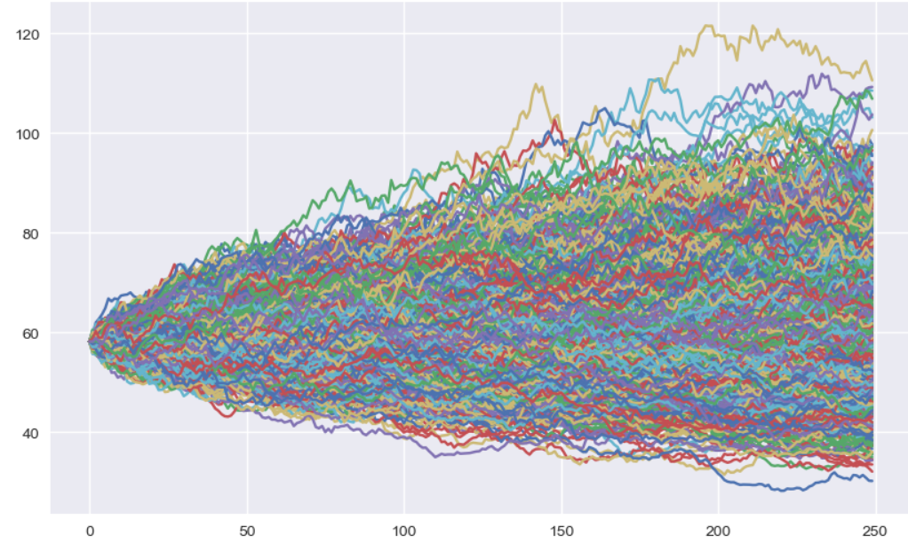
Coca Cola Monte Carlo Simulation
The simulated prices for Coca-Cola show that prices are set between $121.57 and $28.24 with an average of $60.35 and a standard deviation of $9.48 within a one-year timeframe. Coca-Cola illustrates a high consistency with low variation in terms of its price.
Notes:
The simulated prices for Coca-Cola suggest a range between $121.57 and $28.24, with an average price of $60.35 and a standard deviation of $9.48 over a one-year timeframe.
Notably, Coca-Cola demonstrates high consistency in its price behavior with relatively low variation.
Investment Implications:
The consistent performance and predictable returns of Coca-Cola make it an attractive investment option for stable returns within the portfolio.
Its low variation in price suggests a lower level of risk compared to other stocks, providing stability to the overall portfolio.

Slide 31
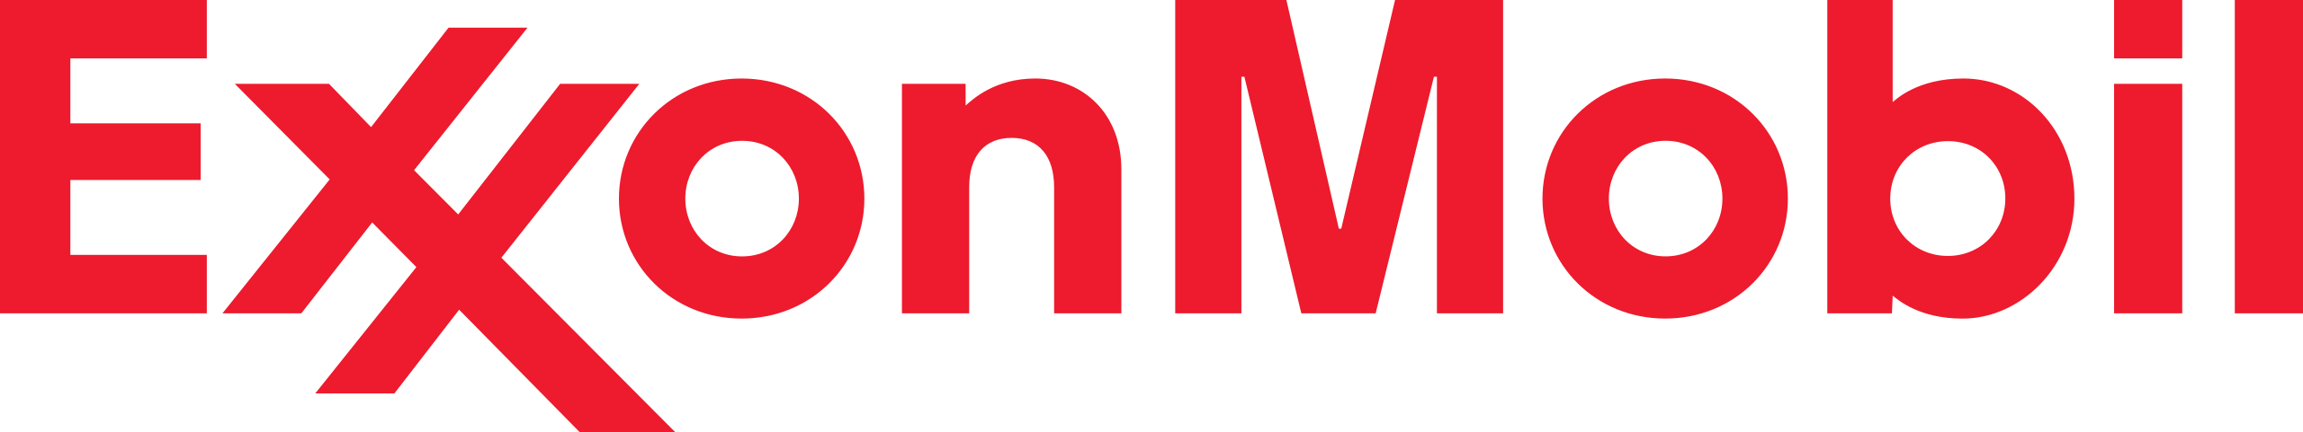
Energy/Oil & Gas Industry

Slide 32
Energy/Oil & Gas Industry Environmental Analysis
Strengths
High demand for energy supports stable revenue, with significant control over global energy supplies
Weaknesses
Environmental concerns and regulatory challenges, along with high capital and operational costs.
Opportunities
Transition to renewable energy sources and technological innovations in extraction and production methods.
Threats
Volatile oil prices and the global shift towards sustainable energy sources threaten traditional revenue models.
Notes:
Energy/Oil & Gas Industry:
Strengths:
Essential role in global energy supply and infrastructure.
Diversified operations across upstream, midstream, and downstream segments.
Long-term contracts and stable cash flows from oil and gas production.
Weaknesses:
Exposure to commodity price volatility and geopolitical risks.
Environmental and social concerns related to carbon emissions and fossil fuel dependence.
High capital expenditures and regulatory compliance costs.
Opportunities:
Technological advancements in renewable energy and alternative fuels.
Expansion into new geographic markets with untapped reserves.
Investments in clean energy initiatives and carbon capture technologies.
Threats:
Shifting energy policies and regulations impacting industry profitability.
Competition from renewable energy sources and electric vehicles.
Supply chain disruptions and geopolitical tensions affecting global energy markets.

Slide 33
Exxon Mobil Financial Analysis
Industry Comparison:
Exxon Mobil's revenue growth has varied greatly and is not in line with the industry average growth of 5%.

Slide 34
Exxon Mobil Financial Analysis
Industry Comparison:
Exxon Mobil's P/E ratio in 2023 is below the industry average of 11.58, suggesting it could be undervalued or that the market expects lower future earnings.

Slide 35
Exxon Mobil Financial Analysis
Industry Comparison:
Exxon Mobil's debt to equity ratio is below the industry average of 0.4, indicating a more conservative use of debt relative to equity.

Slide 36




Exxon Mobil Company Analysis
Major player in energy and oil & gas industry with operations in exploration, production, refining, and marketing.
Facing challenges from renewable energy transition and climate change concerns.
Cost-cutting measures and investment in cleaner energy technologies.
Diversification into natural gas and renewables to adapt to changing market dynamics.
Notes:
Exxon Mobil (Energy/Oil & Gas): Exxon Mobil remains a major player in the energy and oil & gas industry, with operations spanning exploration, production, refining, and marketing. However, the company faces challenges due to the transition towards renewable energy sources, climate change concerns, and fluctuating oil prices. To adapt, Exxon Mobil has been focusing on cost-cutting measures, increasing investment in cleaner energy technologies, and diversifying its energy portfolio to include natural gas and renewables.

Slide 37
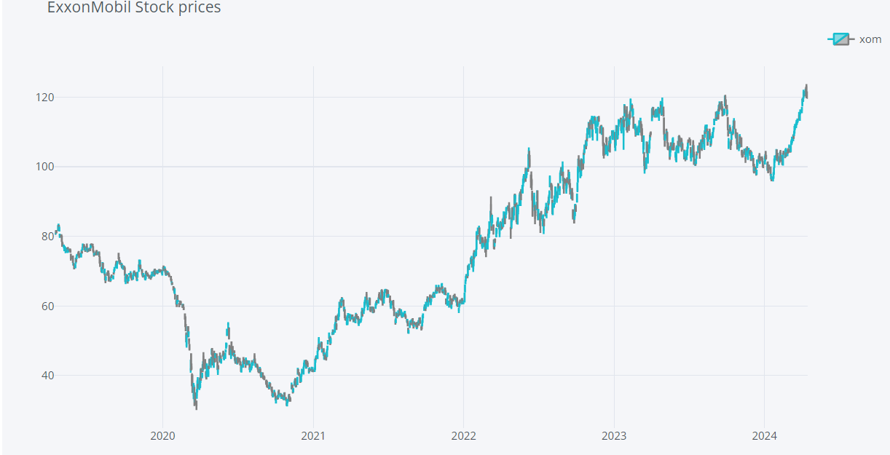
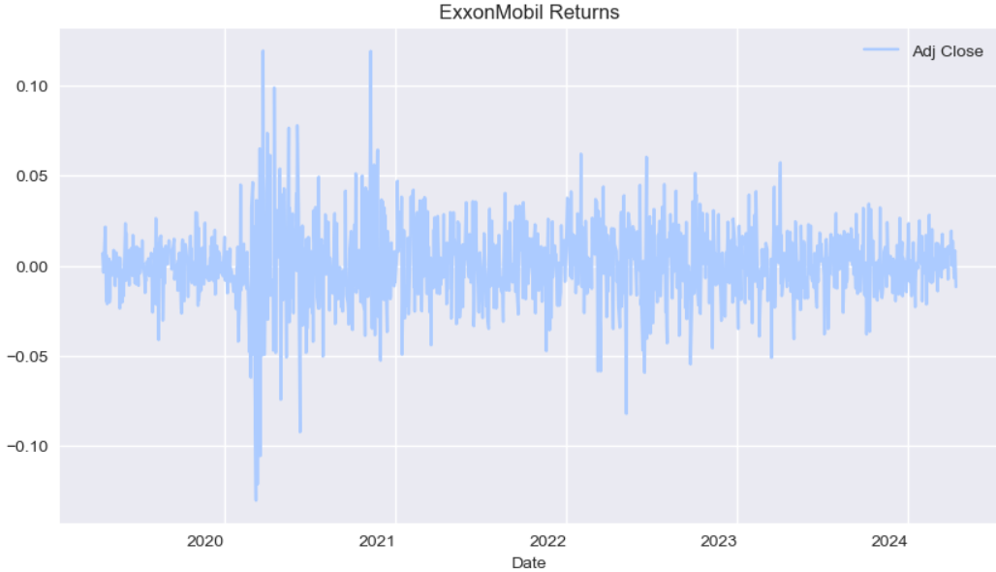
Exxon Mobil’s Past Performance
Exxon Mobil showed a high growth after 2021 and this trend continued until 2024. In terms of its return, there was a high variation between 2020 to 2021 after that the returns tend to be consistence and expected return of 13% in one year.
Stock Price
Returns
Notes:
Exxon Mobil has demonstrated significant growth since 2021, with this trend persisting until 2024.
While there was high return variation between 2020 and 2021, returns have become more consistent thereafter.
We anticipate a steady return of approximately 13% within the next year based on recent performance trends.

Slide 38
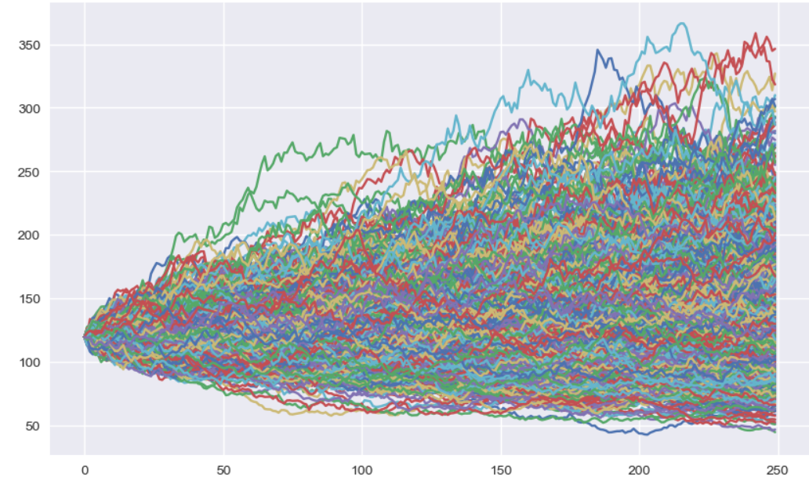
Exxon Mobil Monte Carlo Simulation
The simulated prices for Exxon Mobil show that prices are set between $366.41 and $42.80 with an average of $130.91 and a standard deviation of $33.64 within a one-year timeframe. the moderate average and standard deviation suggest manageable risk levels for investors.
Notes:
The simulated prices for Exxon Mobil range between $366.41 and $42.80, with an average price of $130.91 and a standard deviation of $33.64 over a one-year timeframe.
This indicates a wide price range but with a moderate average and standard deviation.
Investment Implications:
Exxon Mobil's consistent growth trajectory and expected high returns make it an appealing investment choice.
Despite the wide price range, the moderate average and standard deviation suggest manageable risk levels for investors.
The company's performance can contribute positively to the overall portfolio returns and stability.

Slide 39
3
Recommendation Package

Slide 40
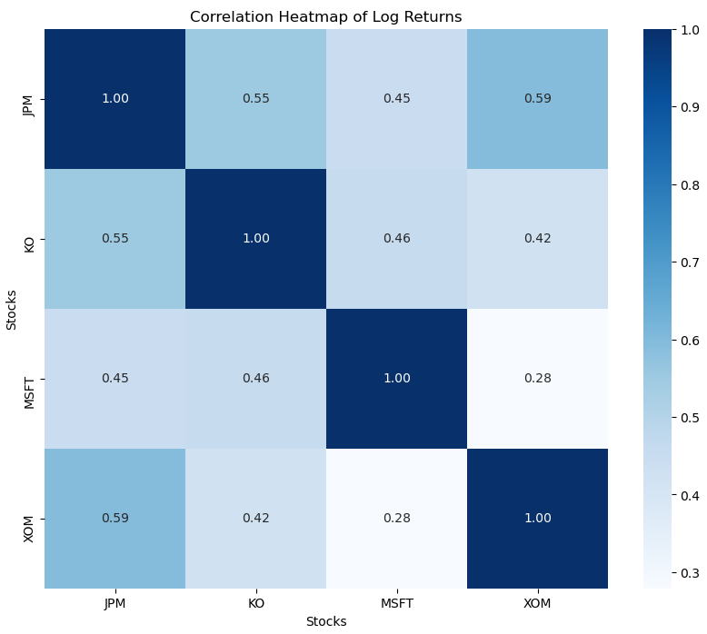
Correlation Between Each Stock
The portfolio exhibits moderate positive correlations between its constituent stocks.
While some correlations are stronger than others, there is no indication of exceptionally high correlations, which suggests a reasonable level of diversification.

Slide 41
Portfolio Optimization
High Risk
Low Risk
Return | 23% | $23,138.30 | 10% | $10,204.90
Volatility | 27% | $27,300.20 | 20% | $20,067.40
MSFT weight | 84% | $84,317.10 | 12% | $11,623.40
JPM weight | 1% | $1,083.50 | 2% | $2,066.40
KO weight | 7% | $6,862.00 | 73% | $73,379.20
XOM weight | 8% | $7,737.40 | 13% | $12,931.00
Notes:
The high-risk portfolio offers a higher return potential but with greater volatility, suitable for investors with a higher risk tolerance.
Conversely, the low-risk portfolio provides a more conservative approach with lower volatility, ideal for investors seeking stability and capital preservation.
Both portfolios are optimized to achieve the best risk-return balance based on the investor's risk preferences and investment goals.

Slide 42
Capital Asset Pricing Model
Stocks | Beta | Expected Return
MSFT | 1.17 | 12%
JPM | 1.09 | 12%
KO | 0.65 | 8%
XOM | 0.87 | 10%
Aggressive Relationship
Defensive Relationship
Notes:
Stocks with higher betas (MSFT, JPM) are considered more aggressive and are expected to provide higher returns to compensate for their higher risk.
Stocks with lower betas (KO, JNJ, XOM) are considered defensive and are expected to provide lower but more stable returns.
Investors can use these expected returns as a guideline for portfolio allocation based on their risk preferences and investment objectives.

Slide 43
4
Q&A

Slide 44
References
Ajana, B. (2017). Digital health and the biopolitics of the Quantified Self. Digital Health, 3, 205520761668950. https://doi.org/10.1177/2055207616689509
Ashwood, L., Pilny, A., Canfield, J., Jamila, M., & Thomson, R. (2022). From Big Ag to Big Finance: a market network approach to power in agriculture. Agriculture and Human Values, 39(4), 1421–1434. https://doi.org/10.1007/s10460-022-10332-3
Baldwin, C. Y., Bogers, M., Kapoor, R., & West, J. (2024). Focusing the ecosystem lens on innovation studies. Research Policy, 53(3), 104949. https://doi.org/10.1016/j.respol.2023.104949
Urbinati, A., Chiaroni, D., Chiesa, V., & Frattini, F. (2019). The role of business model design in the diffusion of innovations: An analysis of a sample of Unicorn-Tech companies. International Journal of Innovation and Technology Management, 16(01). https://doi.org/10.1142/s0219877019500111
Skjærseth, J. B., & Skodvin, T. (2018). Climate change and the oil industry. https://doi.org/10.7765/9781526137296

